Slide 1


Slide 2






Team:
Benjamin Bodner
Wojciech Dudzik
Yuri Lavinas
Nick Ross
Mentor: Penousal Machado

Slide 3
The Problem
Employers screen employee resumes using AI that can be biased by the training data used, resulting in potential employees being rejected on a number of factors such as those that indicate gender

Slide 4
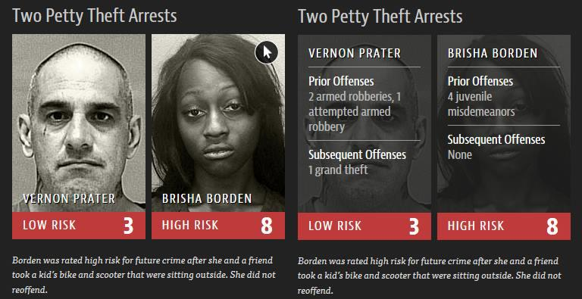
Bias

Slide 5
Ideas
Look at factors on resumes that led to success and check if gender was a factor
Remove all information from resumes that would prevent women getting employed just because of their gender

Slide 6
A Solution
Removing names makes it harder to detect the gender of an applicant, but other factors still indicate gender
Learn from existing resumes the factors that indicate gender
Highlight them for the author, to avoid revealing their gender

Slide 7
Prototype Implementation
Get the data
Learn LSTM about gender
Check what are the keywords
Use gender as a factor (making assumption that it is)
End result:
Highlight text that indicates gender

Slide 8
Data
Find large data sets of resumes*
Dataset with 701 resumes, names included, but not gender
For real product we can use Indeed dataset with 8M examples
*at least 6 big datas might be required ;)

Slide 9
Gender the Data
Using the names of the applicants assign them a gender using a names database
Where the name is ambiguous remove them from the data set
25 resumes were removed leaving 676 resumes for the prototype

Slide 10
Train
Train a deep neural net with our data to classify gender, while picking out key words or sentences
First looking at key words

Slide 11
Results
Sentence | Prediction | GT
Contribution
QA Analyst
7
Troubleshooting
HR Executive
Manager Administration
Supportive and creative
Professional Skills
Assertive
Switching
Cultural Event
Handling escalations

Slide 12
Results
Sentence | Prediction | GT
Contribution | Man
QA Analyst | Woman
7 | Man
Troubleshooting | Man
HR Executive | Woman
Manager Administration | Man
Supportive and creative | Man
Professional Skills | Man
Assertive | Woman
Switching | Woman
Cultural Event | Woman
Handling escalations | Woman

Slide 13
Results
Sentence | Prediction | GT
Contribution | Man | Man
QA Analyst | Woman | Woman
7 | Man | Man
Troubleshooting | Man | Woman
HR Executive | Woman | Man
Manager Administration | Man | Man
Supportive and creative | Man | Man
Professional Skills | Man | Man
Assertive | Woman | Woman
Switching | Woman | Man
Cultural Event | Woman | Man
Handling escalations | Woman | Woman

Slide 14
Results
Accuracy 0.77
 | Precision | Recall | f1-score | Support
Man | 0.79 | 0.94 | 0.86 | 635
Woman | 0.52 | 0.21 | 0.30 | 196

Slide 15
Results
Now on to sentences
Sentence | Prediction | GT
Write technical articles for knowledge base
Incident Management Solution report
A highly consistent and pragmatic approach to problem solving
Can switch to any environment within a short span
Ability to work steadily
To maintain courteous relationship with the customer all the time
Successfully devised strategy DMDC Different model different channel and Managed MOP Market Operating Price
acquired/portfolio work closely with risk
Solve their operation related queries

Slide 16
Results
Sentence | Prediction | GT
Write technical articles for knowledge base | Woman
Incident Management Solution report | Man
A highly consistent and pragmatic approach to problem solving | Man
Can switch to any environment within a short span | Man
Ability to work steadily | Man
To maintain courteous relationship with the customer all the time | Man
Successfully devised strategy DMDC Different model different channel and Managed MOP Market Operating Price | Man
acquired/portfolio work closely with risk | Man
Solve their operation related queries | Woman

Slide 17
Results
Sentence | Prediction | GT
Write technical articles for knowledge base | Woman | Woman
Incident Management Solution report | Man | Man
A highly consistent and pragmatic approach to problem solving | Man | Woman
Can switch to any environment within a short span | Man | Man
Ability to work steadily | Man | Man
To maintain courteous relationship with the customer all the time | Man | Man
Successfully devised strategy DMDC Different model different channel and Managed MOP Market Operating Price | Man | Woman
acquired/portfolio work closely with risk | Man | Woman
Solve their operation related queries | Woman | Man

Slide 18
Results
Accuracy 0.76
 | Precision | Recall | f1-score | Support
Man | 0.77 | 0.98 | 0.86 | 1211
Woman | 0.51 | 0.05 | 0.10 | 381

Slide 19
Live Demo!
Could you do better…?

Slide 20
Future Works
Further development:
Highlighting the gender bias words
Make the research open source
Improve the prototype (DNN model)

